Slide 1
Groves High Parent Information Night
October 10, 2019

Slide 2

Today's Learners. Tomorrow's Leaders.

Slide 3
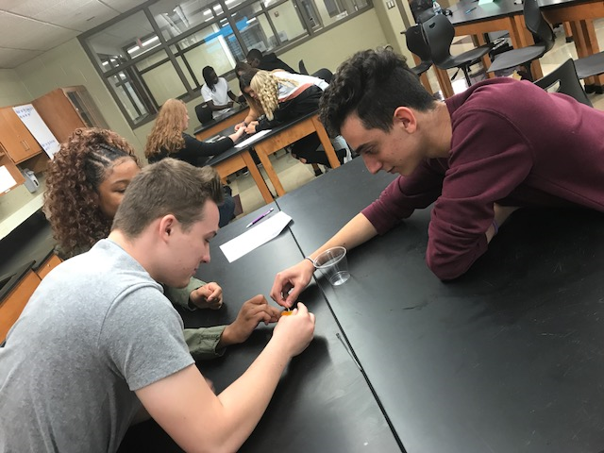
What is OSTC?
Oakland Schools Technical Campus
Public School
4 Technical Campuses
Service 28 Districts
Offer Career Technical Education

Slide 4


Oakland Schools Technical Campus is
Education with purpose!
Students have the opportunity to:
Discover & Explore careers
Find their passion
Find their direction for career/college
Experience Hands-on/Project-based curriculum

Slide 5

Career Opportunities

Slide 6
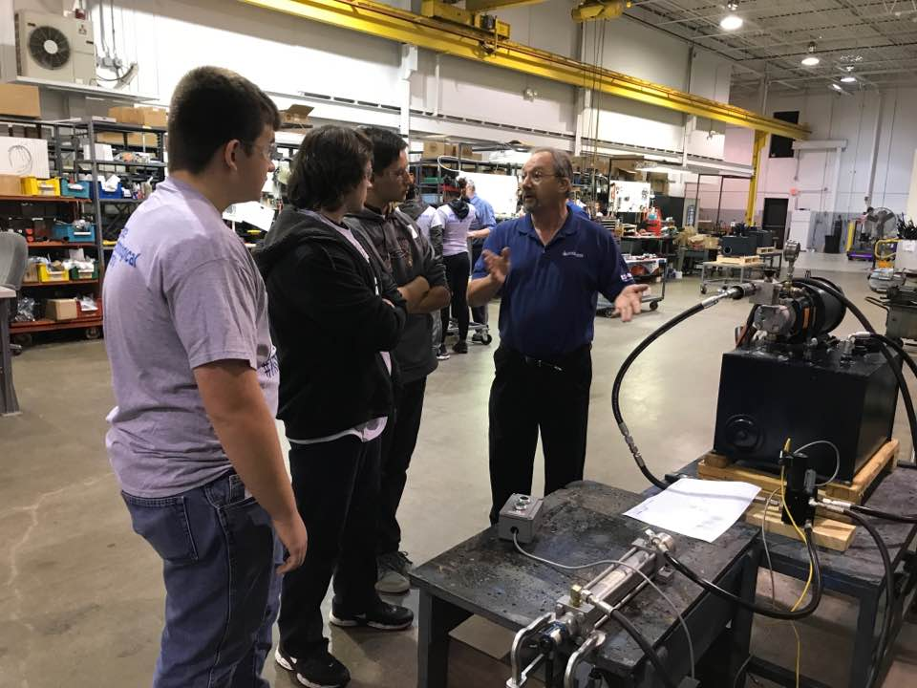
Oakland Schools Technical Campus
Attend junior and/or senior year for ½ of the school day
Earn high school credit (3 elective credits per year)
Some classes offer College Credit/Early College

Slide 7
Career Classes
Automotive Technology: 2 Year Program
Collision Repair and Refinishing: Early College Option
Computer Programming: Early College Option
Construction Technology
Criminal Justice
Culinary Arts and Hospitality
Cyber Security Networking: Early College Option

Slide 8
Career Classes
Energy and Electrical Technologies
Engineering, Robotics, Mechatronics: Early College Option
Entrepreneurship & Adv. Marketing: Early College Option
Health Science
Machining: Early College Option
Visual Imaging (Graphic Design): Early College Option
Welding: Early College Option

Slide 9
Early College Opportunity
No Cost to you the Parent
Junior Year
  OSTC AM
  Groves PM
  OCC 1 class a semester
Senior Year
  OSTC AM
  OCC—3 classes a semester
  Participate in all senior activities
Year 13
  OCC Full time student
  April/May Receive Associate Degree
  Receive High School Diploma

Slide 10
Q & A
Check us out
www.ostconline.com
Open House
1/23/2020
Summer School Opportunity
for Middle School

